Slide 1

Predict Housing Prices
Shashwat Dhayade

Slide 2
Introduction
Dataset contains 79 explanatory variables describing (almost) every aspect of residential homes in Ames, Iowa.
Predict the final price of residential homes in Ames, Iowa
Question
How to handle overfitting and underfitting problem?

Slide 3
Dataset
train.csv - the training set (1460)
test.csv - the test set (1459)
data_description.txt - full description of each column, originally prepared by Dean De Cock but lightly edited to match the column names used here. It contains 79 explanatory variables describing (almost) every aspect of residential homes
sample_submission.csv - a benchmark submission from a linear regression on year and month of sale, lot square footage, and number of bedrooms
It can be downloaded from Kaggle - https://www.kaggle.com/competitions/home-data-for-ml-course/data

Slide 4
Data Preparation
It involves handling missing values, transforming categorical variables to numerical ones, scaling numeric features, and identifying outliers.

Slide 5
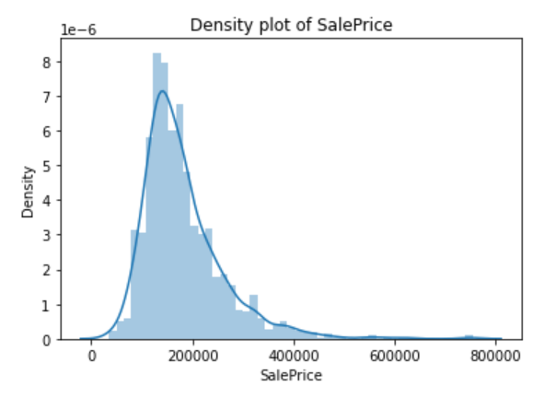
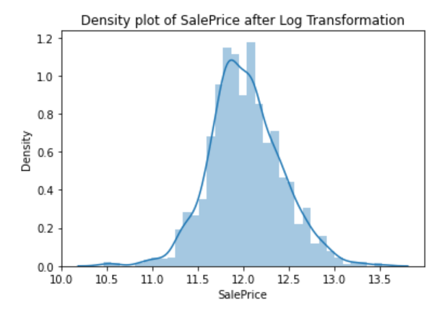
Scaling Numeric Features
I used natural log for transformation reduce the skewness

Slide 6
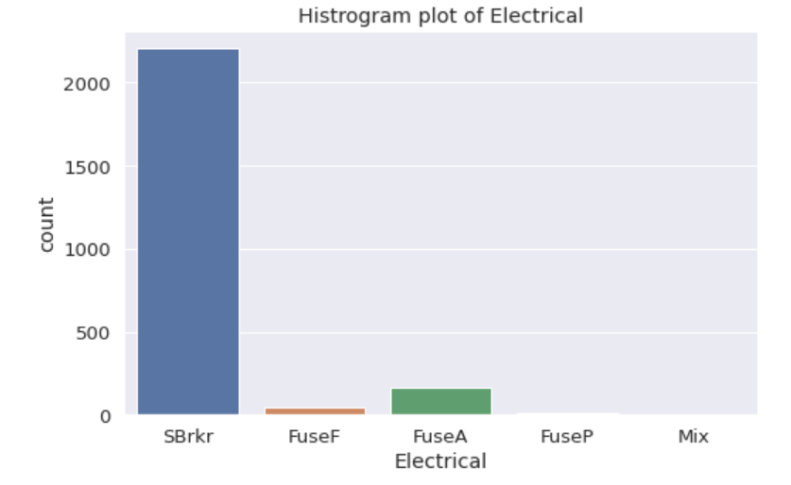
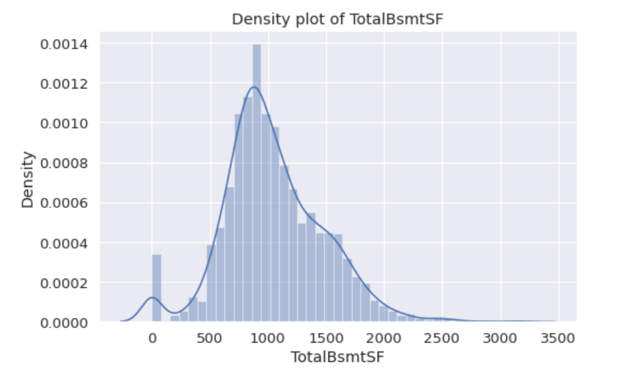
Missing Values
Used value with most frequency
Used median because of skewness

Slide 7
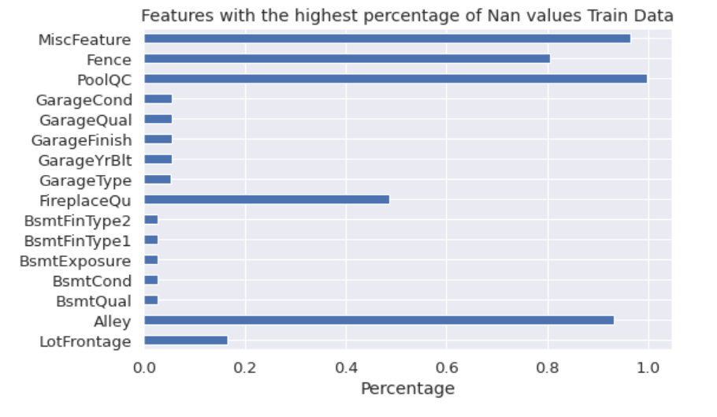
Drop Features
Dropped features with more than 80% NAN values

Slide 8
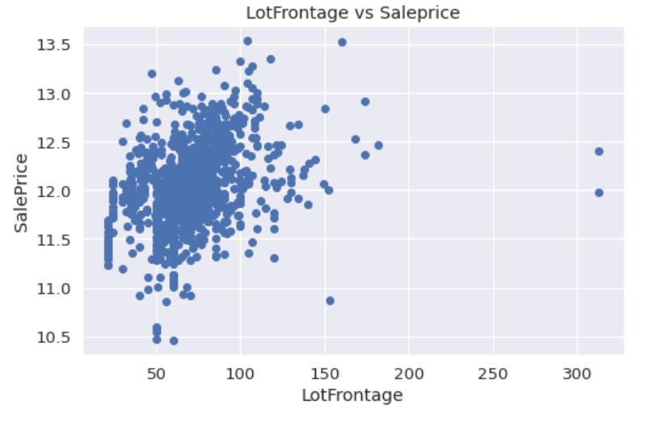
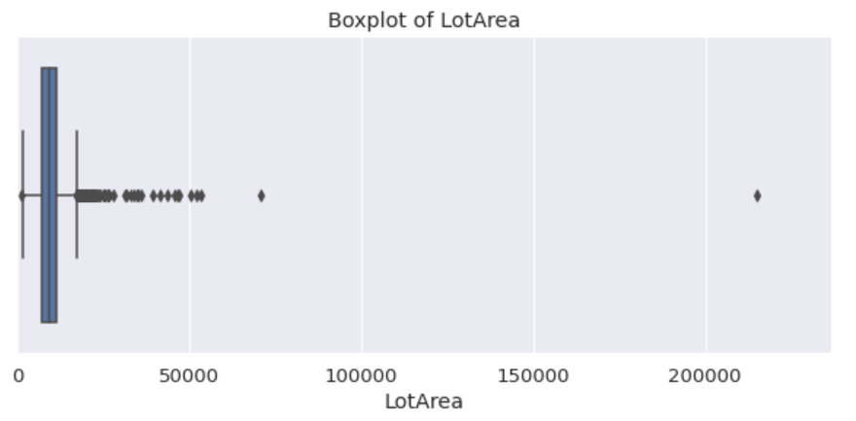
Outliers

Slide 9
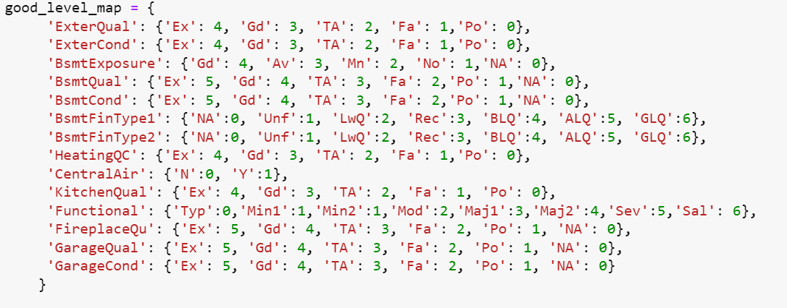
Categorical to Numerical

Slide 10
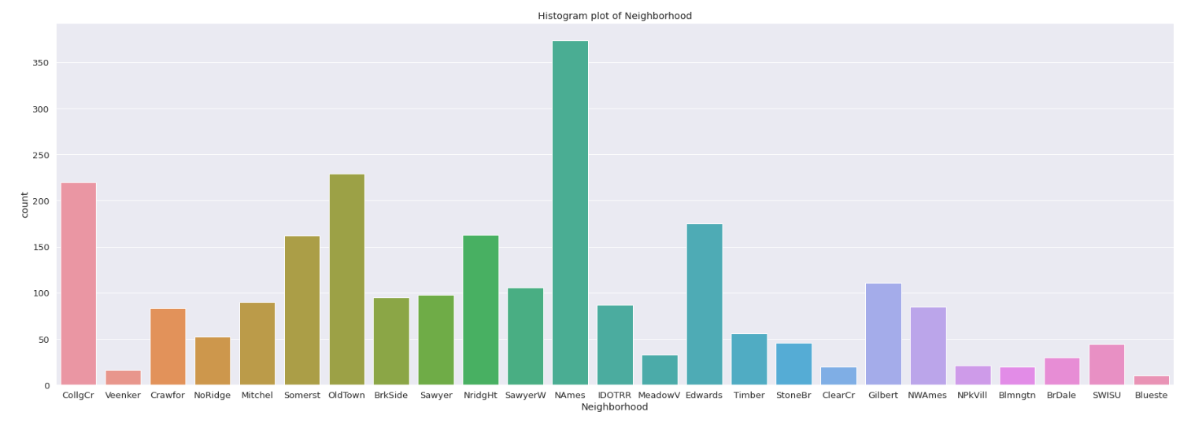
Exploratory Data Analysis
In this project, EDA was conducted to gain insights into the distribution of variables and their correlations with the target variable, SalePrice. Various visualizations such as histograms, scatter plots, and correlation matrices were used to analyze the data.

Slide 11
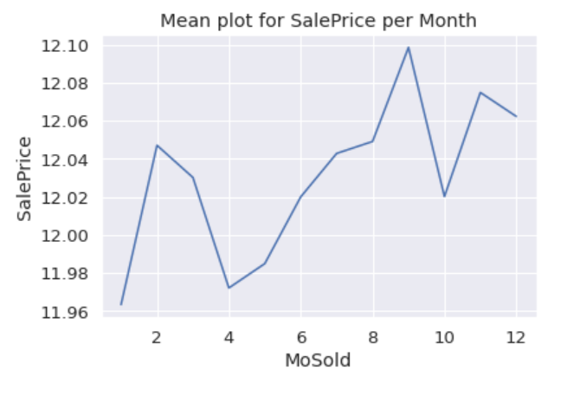
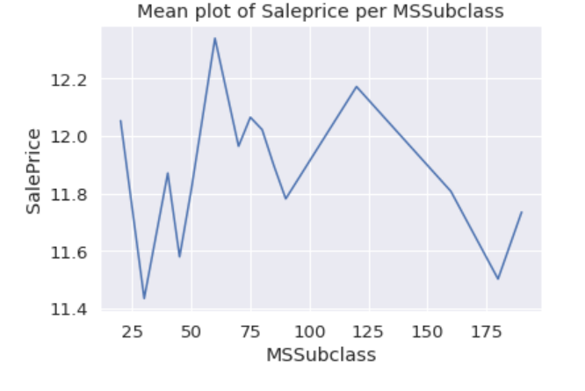
Feature Engineering
I dropped 32 categorical variables from the dataset and added 52 features. Thus, I have 100 features in total and 2426 rows.

Slide 12
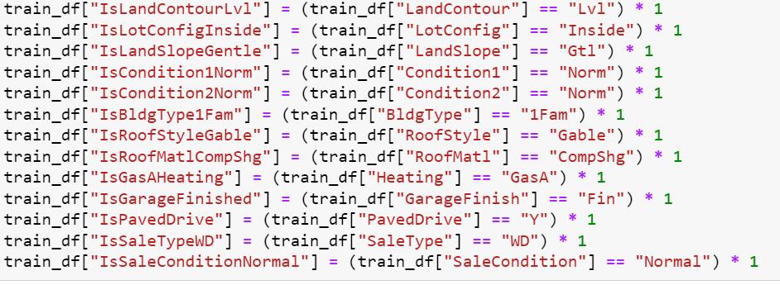
Replace Categorical with Numerical Features

Slide 13
Model Selection
The dataset was split into training (956), test (1231), and validation sets (239).
I used the following models –
Linear Regression
Gradient Boosting Regressor
XGBRegressor

Slide 14
Model Evaluation
The metric used is Root Mean Squared Error (RMSE) between the predicted value and the observed sales price to determine how well the model performs. The RMSE value for the models used are –
Linear Regression – 0.124
Gradient Boosting Regressor – 0.121
XGBRegressor – 0.125

Slide 15
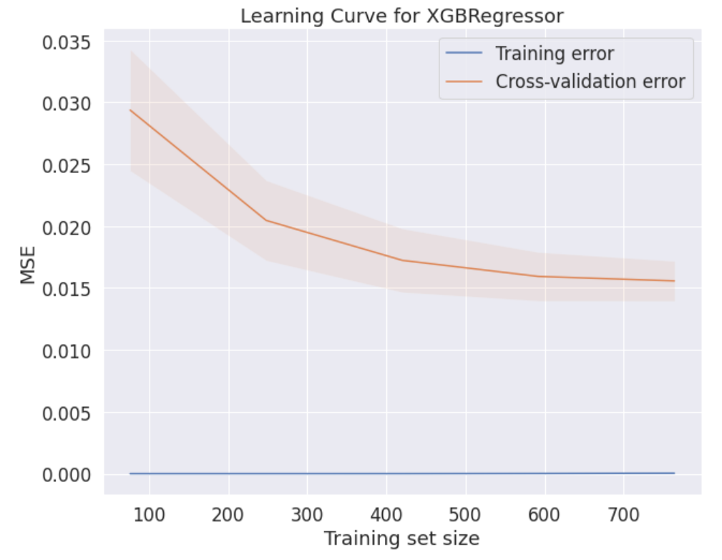
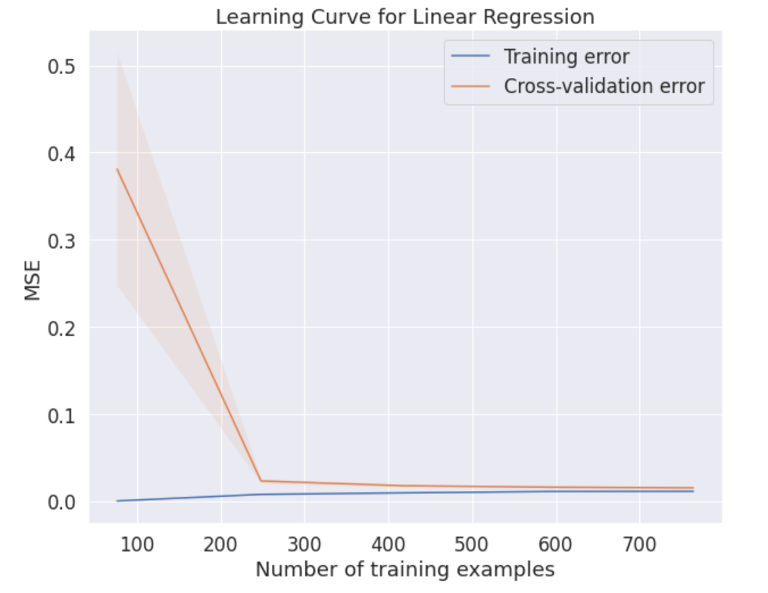
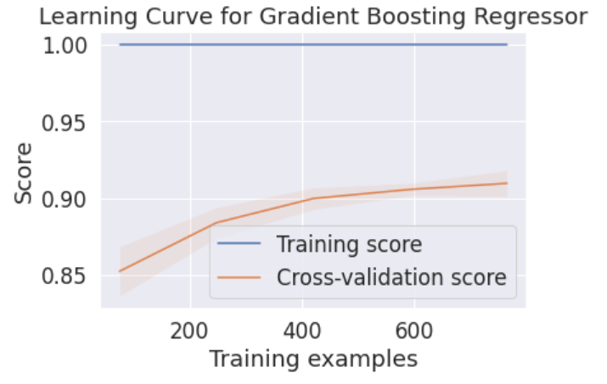
Performance Comparison
Training Score > Cross-validation score: Overfitting
Training Error < Cross-validation error: Overfitting

Slide 16
Result
Linear Regression –
The model and performance plots show that the predicted values and the true values are close to the RMSE of 0.124. The learning curve tells us that the model is overfitting because of its simple understanding of the data. It cannot capture the complexity.
Gradient Boosting Regressor –
The learning curve and RMSE show that the training score is higher than the cross-validation score. This shows that the model might be too complex and fitting noise in training data which makes it overfitting.
XGBRegressor –
The residual plot and learning curve shows that the model might be overfitting. Because the training error is lower than the cross-validation error. But the difference between them is extremely low. This might show that the model might be better than the gradient-boosting regressor. Overall, considering the RMSE value and the plots XGBRegressor model is the best model.

Slide 17
Challenges
The challenges I faced were how to incorporate the categorical variables in the dataset as numerical features. But, in the future Data Understanding will be something I will pay more attention to because the rest of the project depends on it and it helps in saving time rather than fixing upcoming unavoidable errors.

Slide 18
Future Directions and Takeaways
This project can be used in the future for projects involving construction management, and various applications of industrial engineering.
Overall, the project was successful because the RMSE value shows that the XGB model is a good predictor.
Linear regression models can capture linear relationships between the predictors and the response variable.
GBR can capture these complex relationships by building a series of decision trees, where each tree learns to predict the residual error of the previous tree.
One of the main advantages of the XGBRegressor algorithm is its speed and scalability. The algorithm is designed to handle large datasets with high dimensionality, which makes it well-suited for the dataset.

Slide 19
How to handle overfitting and underfitting problem?
The overfitting and underfitting models were handled using an appropriate number of features.
The complexity of the model was kept optimum by trying different hyperparameters.
The split between the train and validation set was optimized to get better predictions.

Slide 20

Thank you

